Slide 1
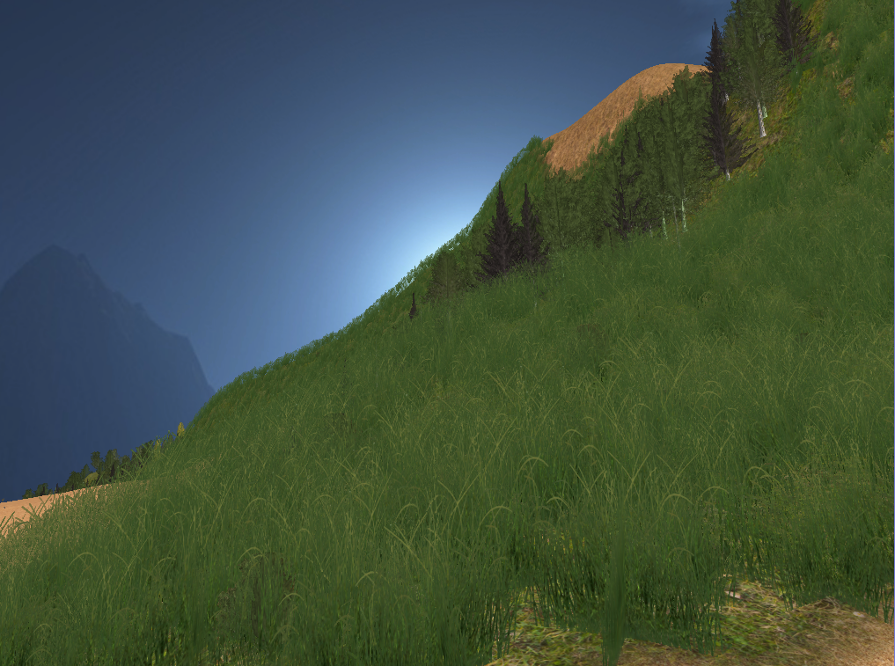
Procedural Terrain
Sebastian Weiss

Slide 2
Why Procedural Terrain?
Large area → exploration
Small details → interest
Endless worlds (e.g. Minecraft)
Time saving for artists
Procedural generation
Artistic control

Slide 3
Overview
Polygonal Map: initial shape
Terrain Features: tune the terrain
Water Erosion: increase realism
Vegetation: add life

Slide 4



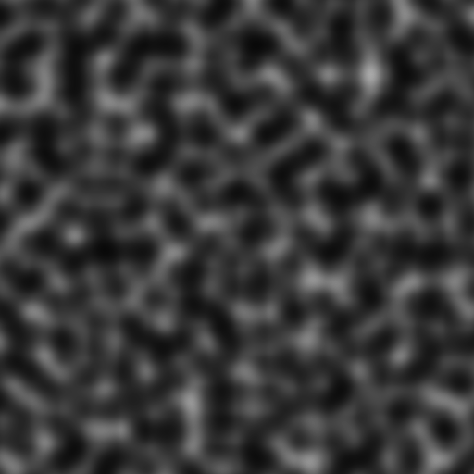
Perlin Noise The programmer’s friend

Slide 5


Slide 6
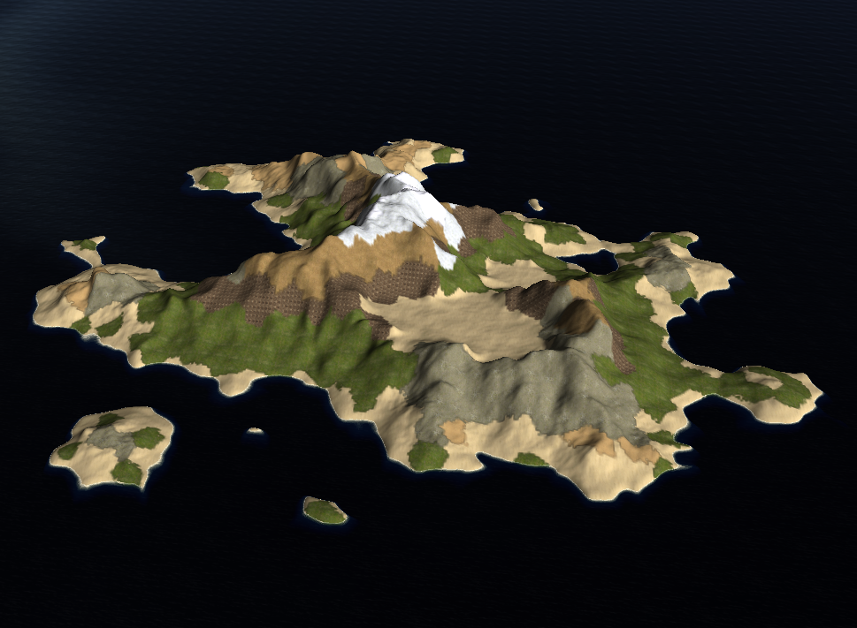
Step 1: Polygonal Map

Slide 7
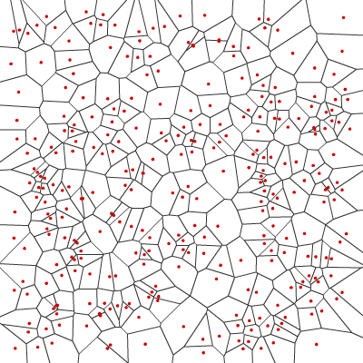
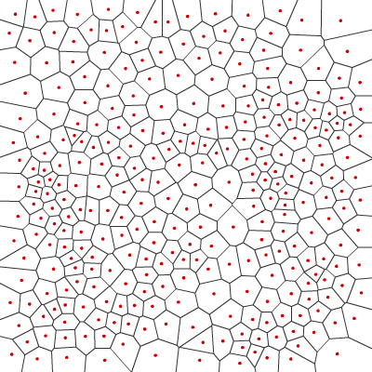
Voronoi diagram

Slide 8
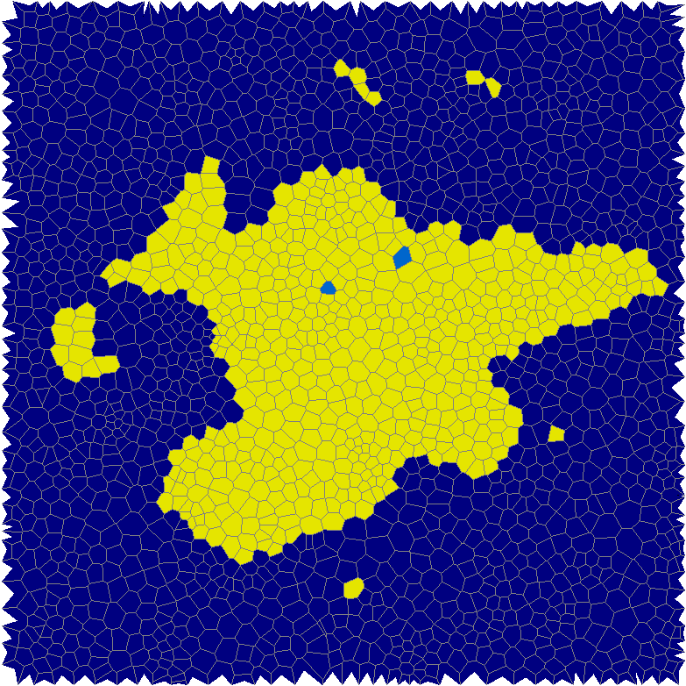
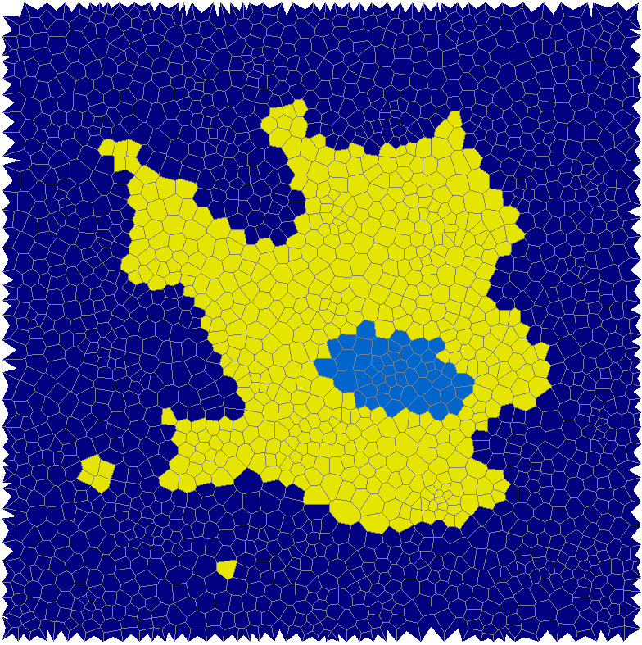
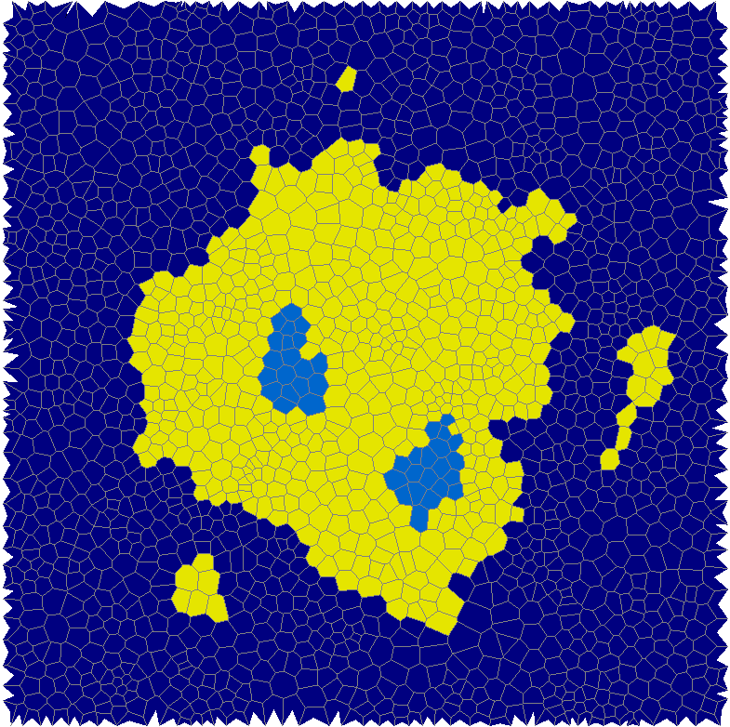
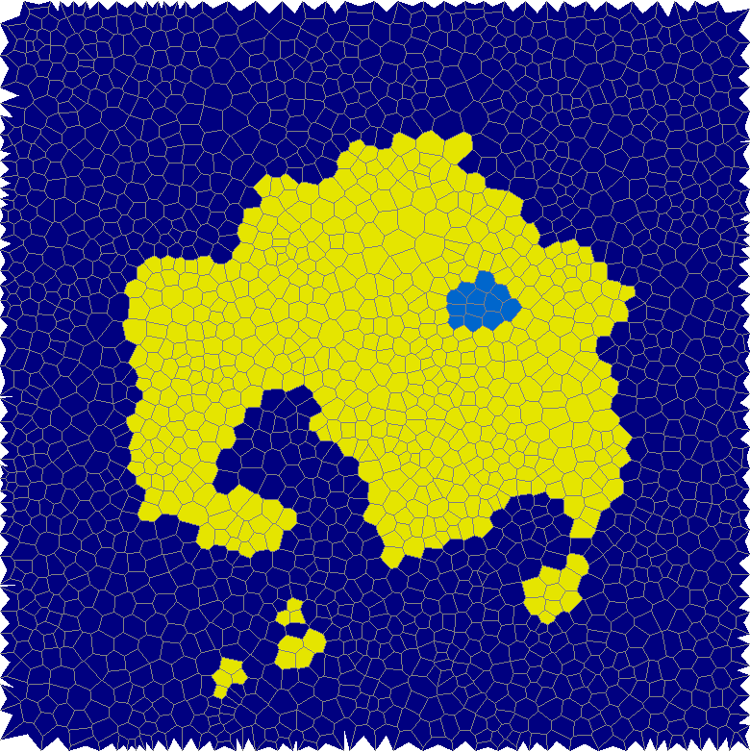
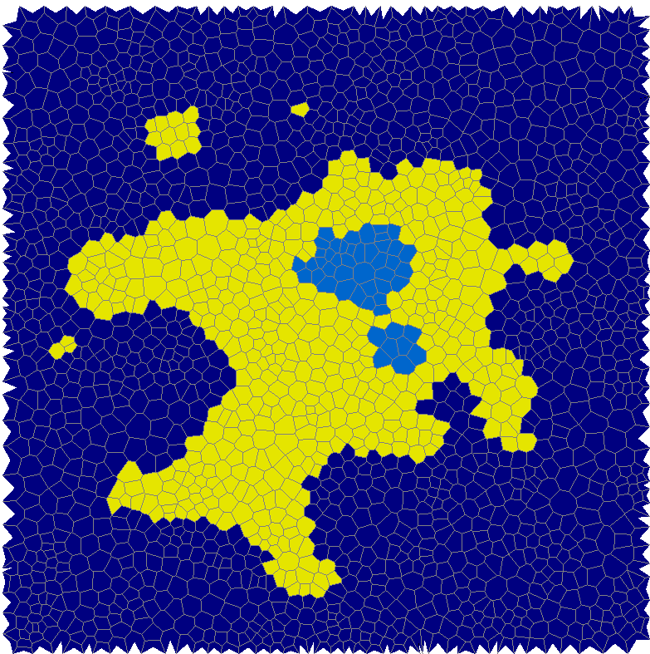
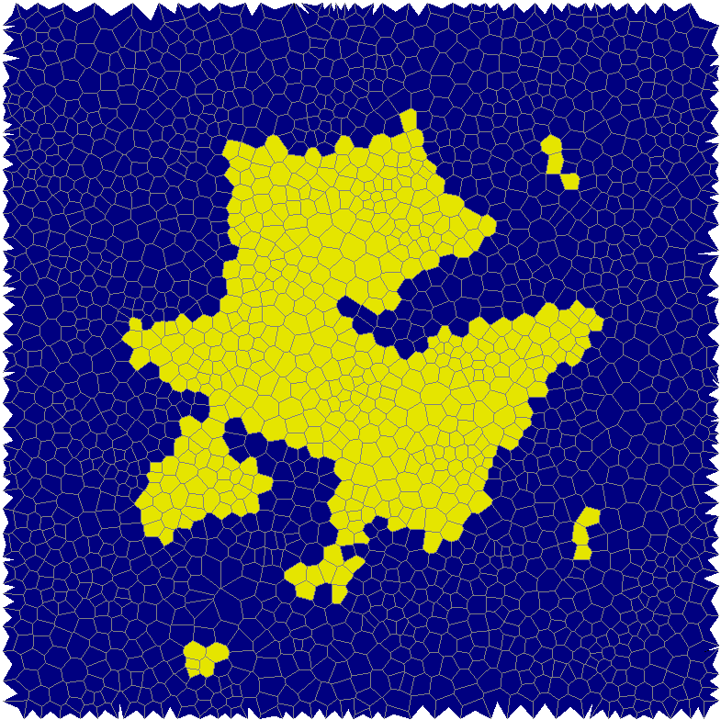
Island shape Perlin noise + distance to the center

Slide 9
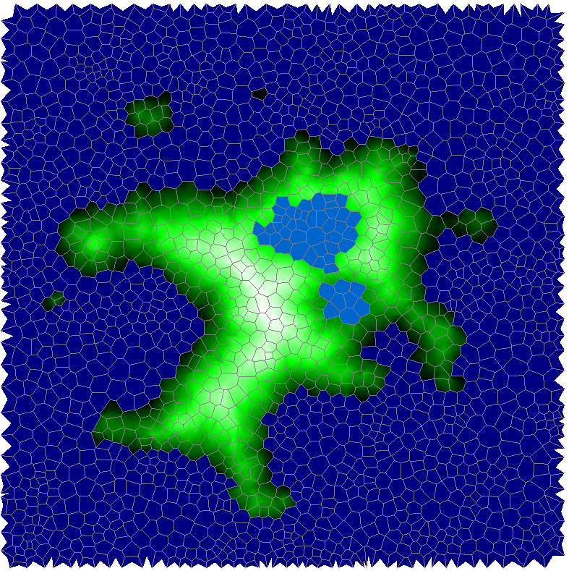
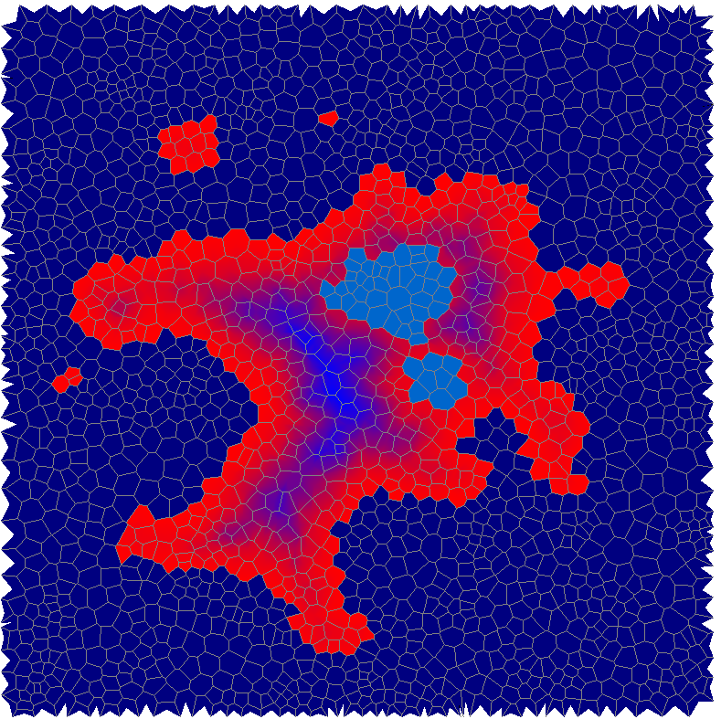
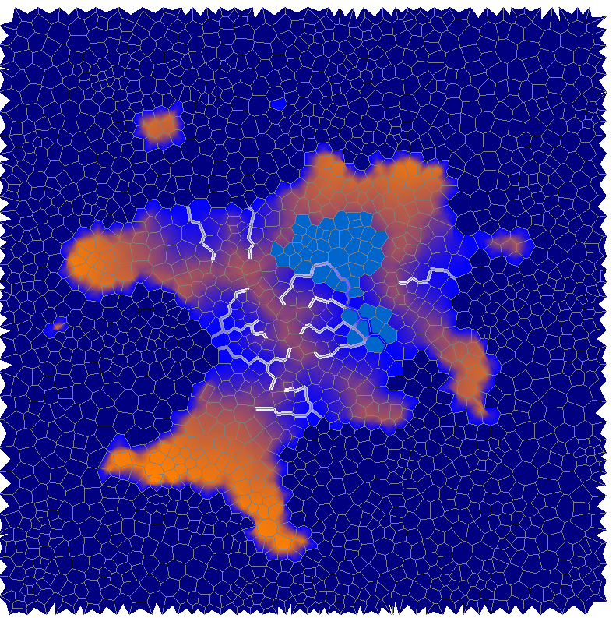
Elevation, Temperature, Moisture

Slide 10
Create height map

Slide 11
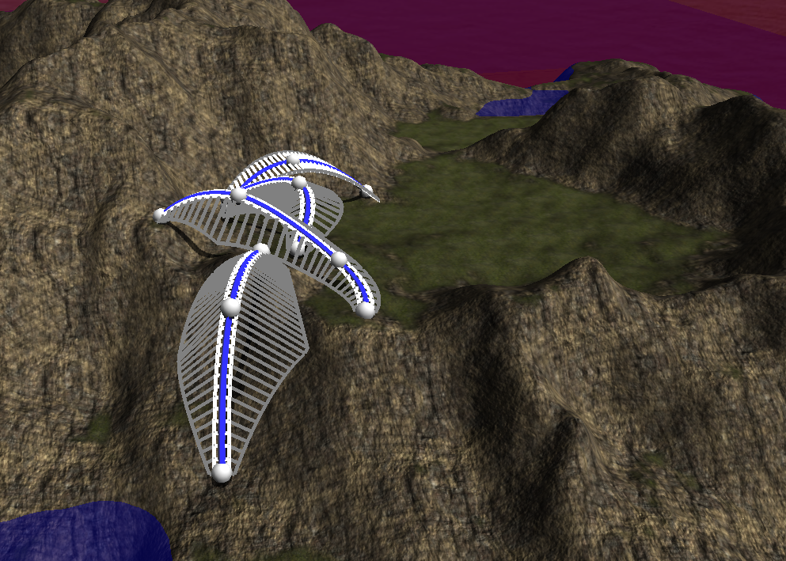
Step 2: Terrain Features

Slide 12
Feature Curves
Interpolation between Control Points
Elevation
Plateau size
Slope size
Slope angle
Smoothing influence

Slide 13
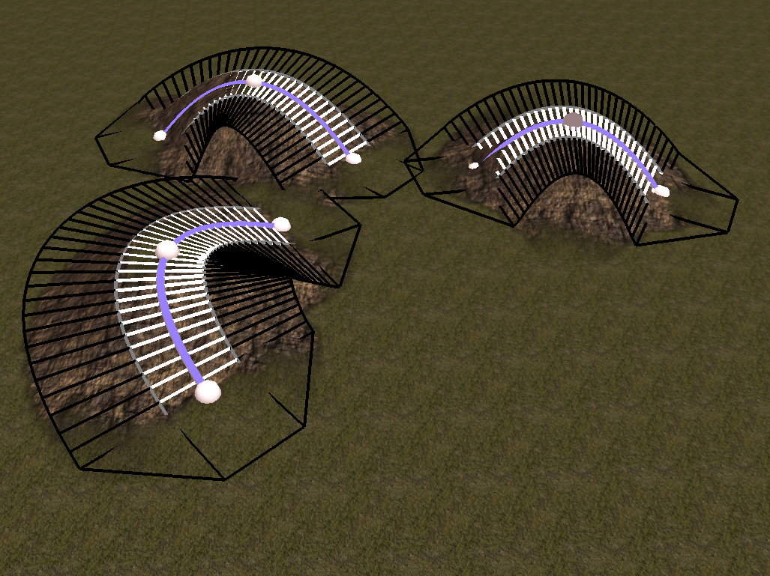
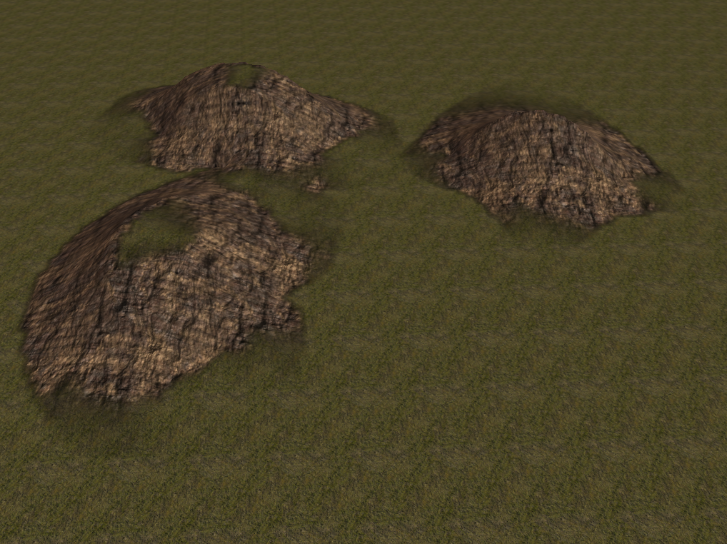
Hills only elevation and smoothing, no slope

Slide 14
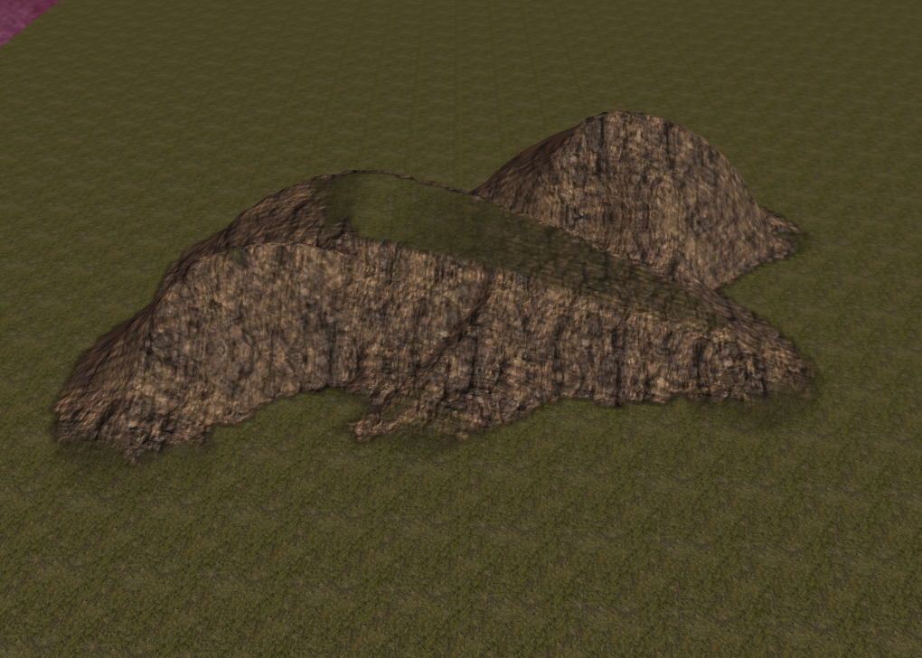
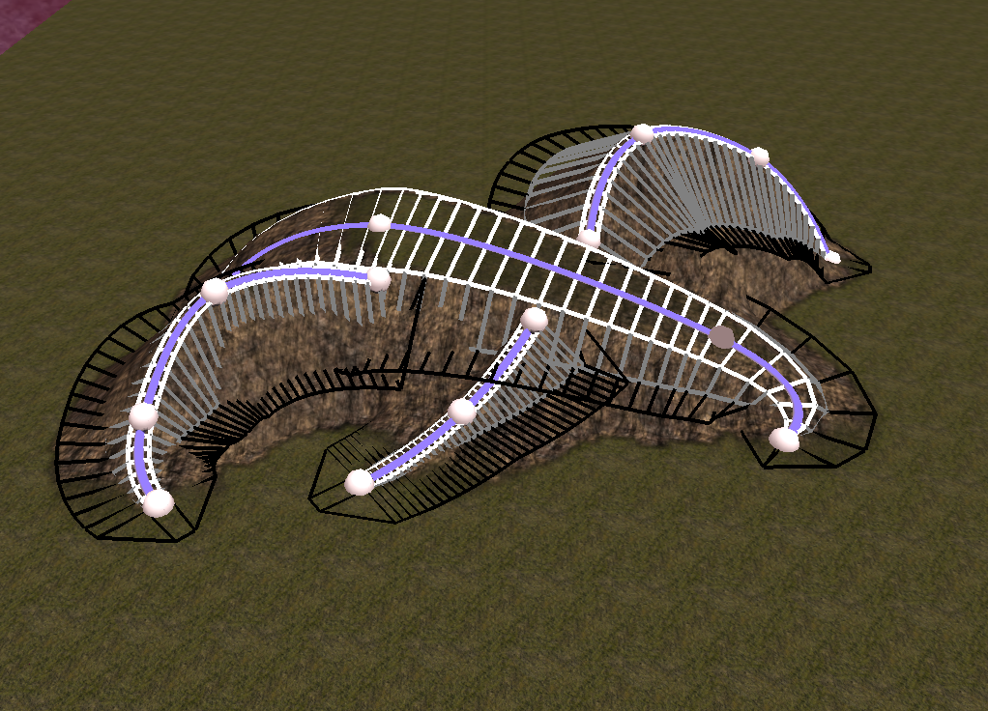
Ridge lines 45° slope

Slide 15
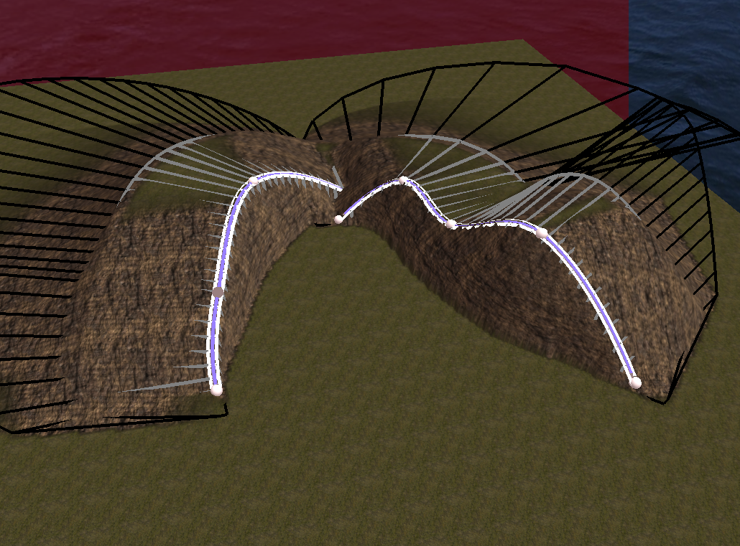
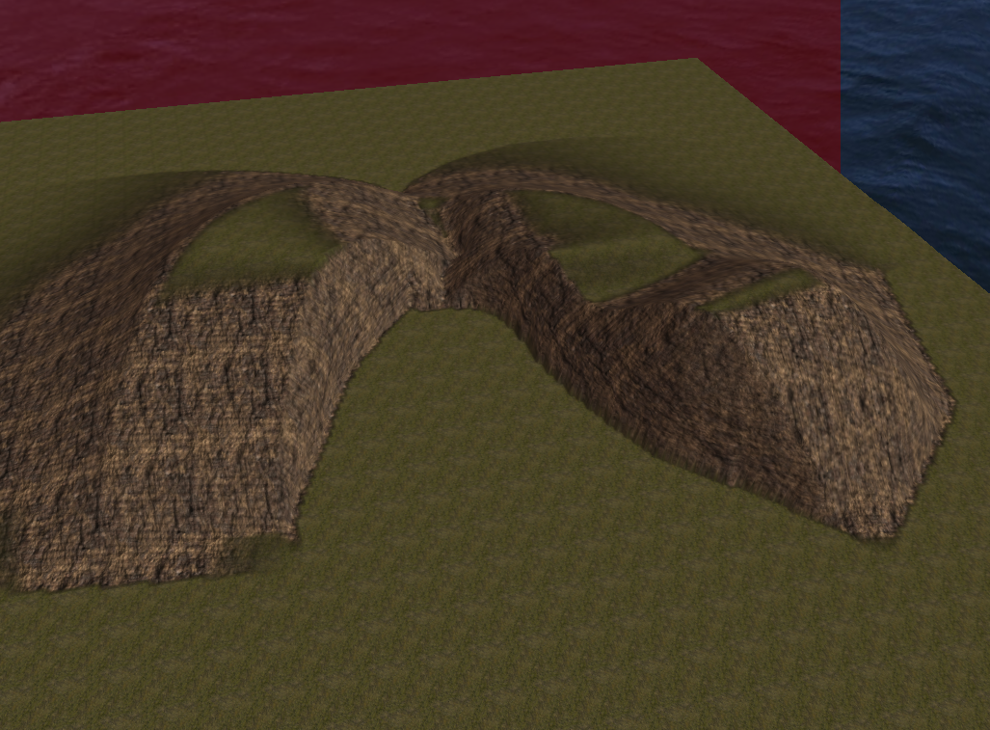
Cliffs 90° slope at one side, long smoothing at the other side

